Slide 1
Microcalcification detection, clustering and features extraction
Presentation of 04/08/2023

Slide 2
I) Background, reminder of last meeting
II) Trying new datasets
Cardiocare
DDSM
III) Extracting matlab features to python and metrics
Extracting matlab features
New Python Metrics
Chosen features to perform clustering on
IV) New functions and ordering
Saving MC_locations and properties to a csv file for Elisaveth and Georges?
Github and ordering the codes

Slide 3
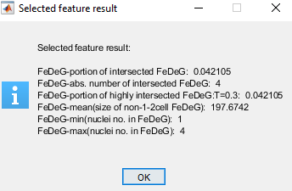
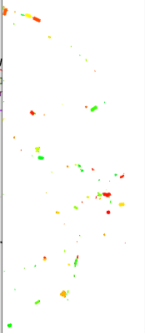
I) Background, reminder of last meeting
Last time :
Second solution completed and performant HPV (FLOCK)
New metrics and clustering techniques tried
Presentation of the threshold of CALC1
Settled objectives :
Clean the code (owned settled )
Try CALC1 and solution 2 on other datasets (Dicoms, DDSM)
Extracting MC_locations/properties of CALC1 in a csv file for Elisaveth and Georges
- Extracting MATLAB output for metrics in python and find new metrics?
Clusters and FeDeG with last option and h_s=40 (solution 2)

Slide 4
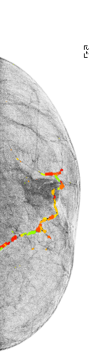
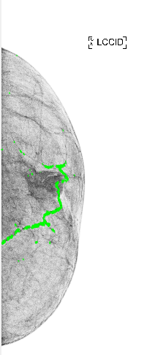
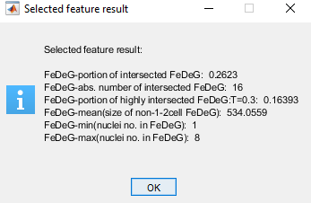
II) Trying new datasets
1) Cardiocare dataset with dicoms format
Results for EEB00A05
- Issue of size: because of limited memory on jupyter
- Issue of background: -> new function inversing colors
If the background is white

Slide 5
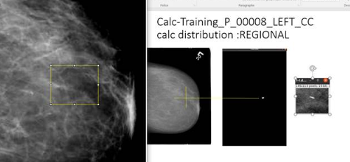
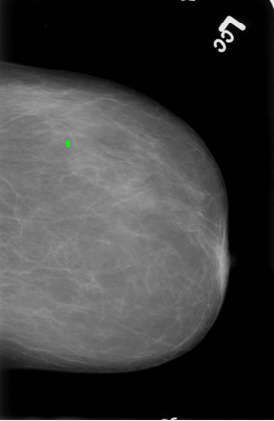
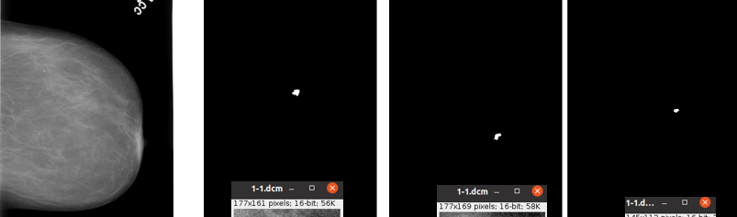
**Show extra diapostive **
2) DDSM
No dicom dataset for this one ?
Output of CALC1
Ground truth

Slide 6
III) Extracting matlab features to python and metrics
1) Extracting matlab features
- Not finished yet -> need to spend more time on Lconstruct-FeDeG_v3.m and function
**Show MATLAB?**

Slide 7
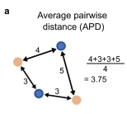
2) New Python Metrics
AMD between clusters:
calculate_minimal_distance_between_2_clusters
calculate_pairwise_AMD_between_clusters
calculate_AMD_among_clusters
McIN (Nb of Mc given a radius R) : How do we choose R?
count_MC_in_radius_for_a_specific_MC
count_Mc_IN_general
APD : not implemented, usefull?

Slide 8
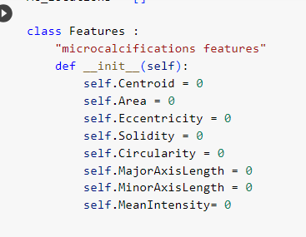
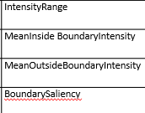
3) Chosen features to perform clustering on
**Show GUI**
Selected features
Not sure of how pertinent Solidity is: because most of the MC are compact
Histogram of values
Those parameters haven’t been considered in the second list but might be in the future to consider the close neighborhood:

Slide 9
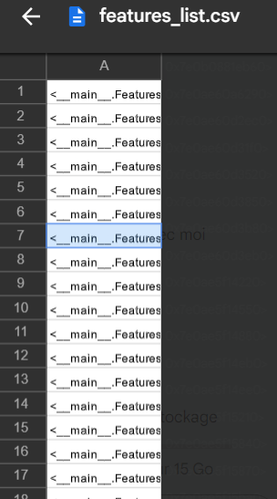
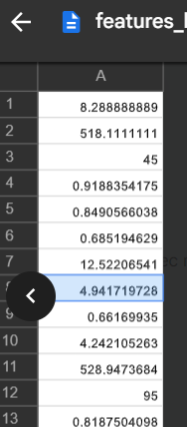
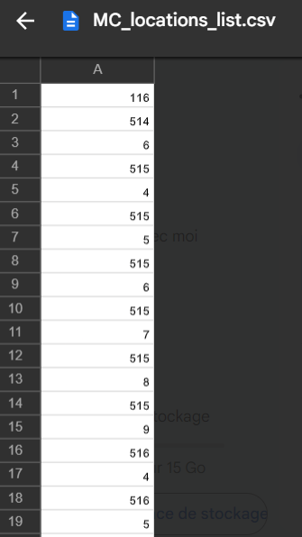
IV) New functions and ordering
Saving MC_locations and properties to a csv file for Elisaveth and Georges?
Format right now :
-head = number of MC kept
-coordinates,
-each MC separated by a 0
2 Formats right now :
-list of values, size of MC_nb*Properties_nb
-structure list size of MC_nb
What do you prefer?

Slide 10
2) Github and ordering the codes
**Show github account **
Now instead of a too messy and large jupyter script, 2 python files (new_core.py and auxiliar_functions.py ) are loaded as the beginning of the jupyter script
Basically the same as previous core.py with the pre-treatment added in the case of a white background (in the 2 loads functions ) in order to make the code more general
Containing all the others functions: plotting, pre-treatment (post prediction), labeling, calculating features and MC_locations, metrics, forming clusters with python approaches, and saving functions,

